Slide 1
2014 – 2015 Officers
Sara Lewis (Student Financial Aid), Staff Council Chair
Joe Boehm (Custodial & Building Maintenance), Vice Chair
Stephane Menand (International Affairs), Treasurer
Michelle Vannatta (Facility Operations), Secretary

Slide 2
Staff Fall Appreciation
October 31 – At the Puck
9:00 am to 10:30 am
In appreciation for your hard work and dedication
to Missouri S&T, we would like to invite you to join
us for FREE hot chocolate and hot apple cider!
(Staff ID required – sponsored by Staff Council)

Slide 3
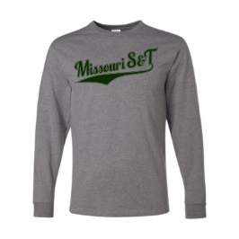
PUMPKIN CARVING CONTEST!
Drop off your carved pumpkins between 8:30 and 8:45 to our tent at the puck. They will be voted on and a $30 gift card for S&T Bookstore will be given!
Staff Council will also be selling long-sleeve t-shirts for $13. Buy one at the tent (cash or check) or contact Patti Adams at adamspat@mst.edu to place an order.

